Slide 1
Visualizing employee attendence trends with excel charts

Slide 2
INTRODUCTION
• It can often be difficult to interpret Excel workbooks that contain a lot of data. Charts allow you to illustrate your workbook data graphically, which makes it easy to visualize comparisons and trends.

Slide 3
To insert a chat
• Select the cells you want to chart, including the column titles and row labels. These cells will be the source data for the chart. • From the Insert tab, click the desired Chart command. In our example, we’ll select Column. • Choose the desired chart type from the drop-down menu. • The selected chart will be inserted in the worksheet. • If you’re not sure which type of chart to use, the Recommended Charts command will suggest several different charts based on the source data.

Slide 4
Types
• Excel has several different types of charts, allowing you to choose the one that best fits your data. In order to use charts effectively, you’ll need to understand how different charts are used. Here I m explaining 12 types of charts. Types of Charts

Slide 5
Column charts
• Column charts use vertical bars to represent data. They can work with many different types of data, but they’re most frequently used for comparing information. Column

Slide 6
Line charts
• Line charts are ideal for showing trends. The data points are connected with lines, making it easy to see whether values are increasing or decreasing over time.

Slide 7
Pie charts
• Pie charts make it easy to compare proportions. Each value is shown as a slice of the pie, so it’s easy to see which values make up the percentage of a whole.

Slide 8
Bar charts
• Bar charts work just like column charts, but they use horizontal bars instead of vertical bars.

Slide 9
Area charts
• Area charts are similar to line charts, except the areas under the lines are filled in.

Slide 10
Surface charts
• Surface charts allow you to display data across a 3D landscape. They work best with large data sets, allowing you to see a variety of information at the same time.

Slide 11
Pareto charts
• The Pareto Chart is a built-in chart type in Excel 2016. A Pareto chart is a variant of the histogram chart, arranged in descending order for easy analysis. The sequencing is performed automatically. Sales by Client Pareto Chart 80/20 An11 Pareto charts • The Pareto Chart is a built-in chart type in Excel 2016. A Pareto chart is a variant of the histogram chart, arranged in descending order for easy analysis. The sequencing is performed automatically. Sales by Client Pareto Chart 80/20 Analysis

Slide 12
Candlestick Charts
• This chart type automatically plots the full range of values as a single line, with indicates high and low in a given time interval. On top of the line is a bar which indicates open and close values. • A Candlestick chart is a built-in chart type in Excel normally used to show stock price activity. You’ll find this chart under the Stock category of chart types, with the name Open-High-Low-Close, sometimes abbreviated OHLC. Dark bars indicate close price is less than open price (a loss), light bars indicate a close price greater than open price (a gain).

Slide 13
Bubble charts
• The Bubble Chart is a built-in chart type in Excel. Bubble charts are a special kind of XY chart that can display another data series which is used to scale the bubble (marker) plotted at X and Y values.

Slide 14
Radar charts
• The Radar Chart is a built-in chart type in Excel. Radar charts, sometimes called spider charts, have one axis per category which all use the same scale. Performance Review Summary Technical Skill Work ethic Experience Sense of humor Accomplishments Personality EXCELJETO16 • The axes of a radar chart radiate out from the center of the chart and data points are plotted on each axis using a common scale. The result is a geometric shape that shows “at-a-glance” performance across all categories. • Radar charts can be used to plot the performance of employees, athletes, products, and companies in various categories. They can be used for performance evaluations and satisfaction surveys.

Slide 15
Clustered charts
• A clustered bar chart displays more than one data series in clustered horizontal columns. Each data series shares the same axis labels, so horizontal bars are grouped by category.

Slide 16
Doughnut charts
• Doughnut charts are meant to express a “part-to-whole” relationship, where all pieces together represent 100%. Doughnut charts work best to display data with a small number of categories (2-5). What’s your favorite ice cream flavor? Maabetty Vanilla 27% Chocolate 55% EXCELJETO

Slide 17
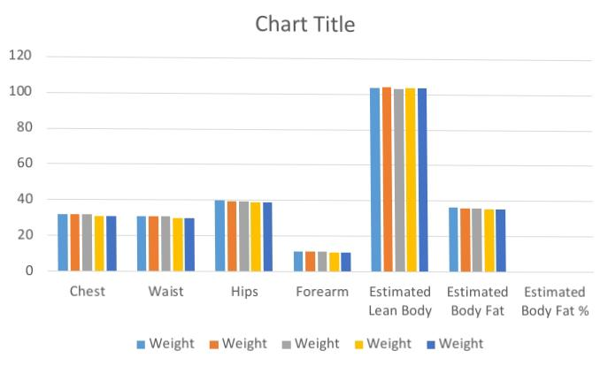
Result

Slide 18
THANK YOU...

